Slide 1
Put ‘em where they Belong!
Image Classification Using Deep Learning

Slide 2



hello!
Arun Teja
Shashi Chebrolu
Madhu Kiran
We are from gulp.com, a restaurant search & discovery website and we are here to present a machine learning algorithm to classify user submitted images according to ‘tags’ defined by the business

Slide 3
1.
The Problem

Slide 4
2,500,000,000,000,000,000
= 2.5 Quintillion
That is the bytes of data generated every day.
Around a million photos are uploaded into restaurant review website everyday.
Who classifies these according to the business requirement?

Slide 5
Big concept
&
Our Solution

Slide 6
“Machine Intelligence is the last invention humanity will ever need to make”

Slide 7
Image Classification using Machine Learning
First off, we define & create tags as per the business requirement. That way visitors can easily navigate into pages where they can find what they are looking for, with ease.
Then we create a deep learning algorithm using Convoluted Neural Network that would automatically classify the photos into tags.
The model can be extended into other websites in the future by modifying according to the requirement.

Slide 8
Methodology
Primary data set was acquired from yelp’s publicly available user submitted images containing 280,000 images
9 tags were created namely:
{0: 'good_for_lunch', 1: 'good_for_dinner', 2: 'takes_reservations', 3: 'outdoor_seating’, 4: 'restaurant_is_expensive', 5: 'has_alcohol', 6: 'has_table_service', 7: 'ambience_is_classy’, 8: 'good_for_kids’}
For training the model, 1000 images for each tag were fed. Data was split into training & validation in the ratio 70:30.
Two models were imported, VGG16 & ResNet. Layers were created on the two models and compared among each other.
VGG16 was found to be the better model which was ultimately implemented.

Slide 9
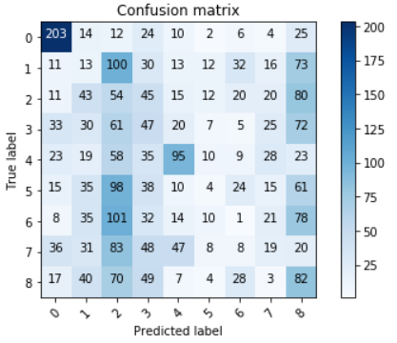
Inferences
VGG16 was the better model with an accuracy of ~30%
Confusion Matrix: To compare the predicted vs actual label
Limitations:
Initially 280,000 images were fed into the model. Amazon’s AWS GPU services was used for processing. Due to limited memory, total images had to be reduced to ~10,000.
With better processing resources, accuracy could be improved drastically

Slide 10
thanks!
Any questions?
You can find us at
@shashichebrolu
@madhukiran644
@aruntejabk

Slide 11
Appendix
The attached Jupyter notebook contains the code and results
Primary dataset was from yelp.com. Link to the data set:
https://www.kaggle.com/c/yelp-restaurant-photo-classification/data

